Slide 1
Symbols and Formulae
1

Slide 2
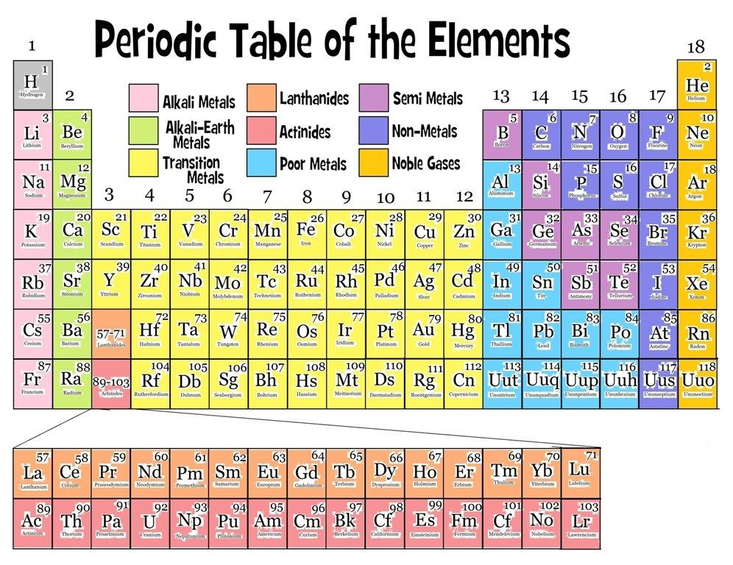
CASE/ PROBLEM / EVENT/ BRAINSTORMING
RELATED TO THE CONCEPT
5/26/2020
TOPIC/COURSE CODE-NAME/FACULTY/DEPT/COLLEGE
2/10

Slide 3
CONTENT SLIDE
5/26/2020
TOPIC/COURSE CODE-NAME/FACULTY/DEPT/COLLEGE
3/10

Slide 4
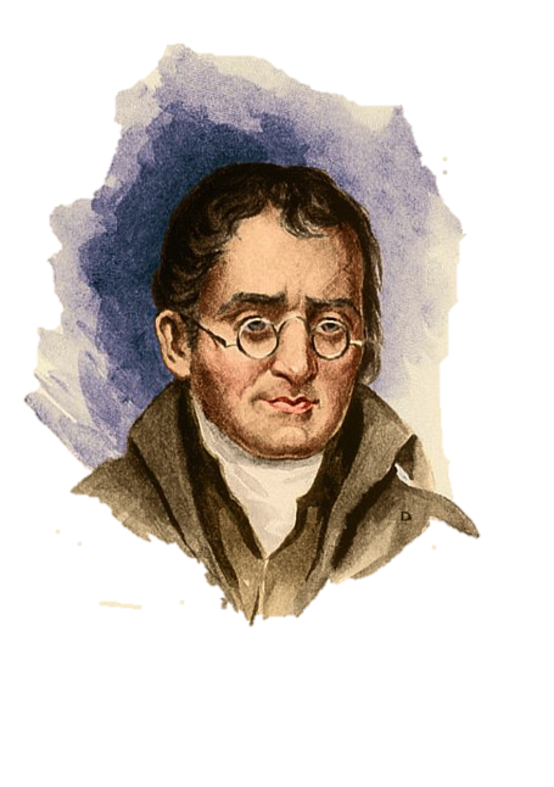
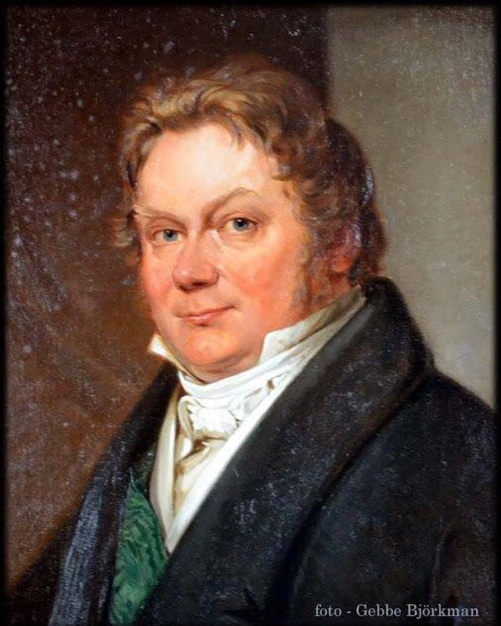
CONTENT SLIDE
5/26/2020
TOPIC/COURSE CODE-NAME/FACULTY/DEPT/COLLEGE

Slide 5
5/26/2020
TOPIC/COURSE CODE-NAME/FACULTY/DEPT/COLLEGE
6/10

Slide 6
FORMULAE

Slide 7
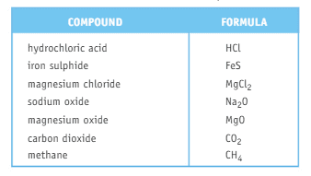
CONTENT SLIDE

Slide 8
QUESTIONS RELATED TO ABOVE SLIDES

Slide 9
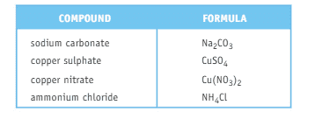
REFERENCES & THANKING SLIDE

